Slide 1

Sentiment Analysis of Amazon Reviews
Hélène, Alexander, Dennis

Slide 2
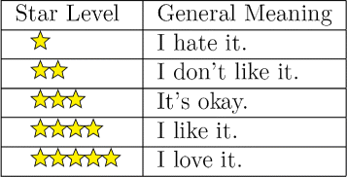
Dataset: Amazon Reviews for Sentiment Analysis
This dataset consists of a few million Amazon customer reviews (input text) and star ratings (output labels)
The reviews are short texts (3.6 millions in training, and 400,000 in testing), considered either positives (ratings 5 or 4 stars on Amazon) or negatives (1 or 2 stars). Neutral reviews (3 stars) are not included in this dataset.
Training set
1,800,000 in class 0
1,800,000 in class 1
Test set
200,000 in class 0
200,000 in class 1
Source: https://www.kaggle.com/bittlingmayer/amazonreviews

Slide 3
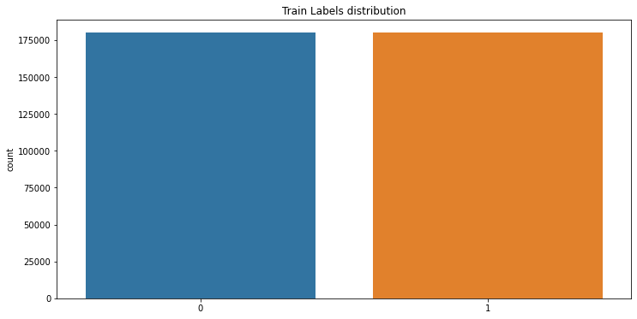
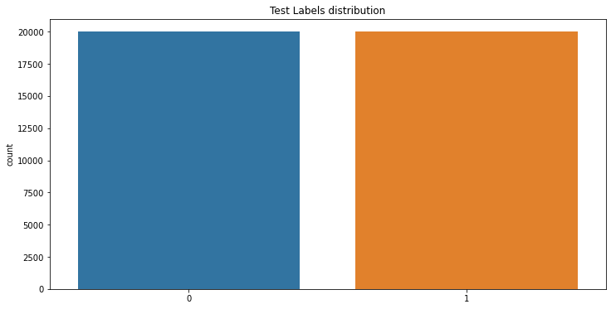
Subset data for processing
We only consider 10% fo the data:
Training set
180,000 in class 0
180,000 in class 1
Test set
20,000 in class 0
20,000 in class 1

Slide 4
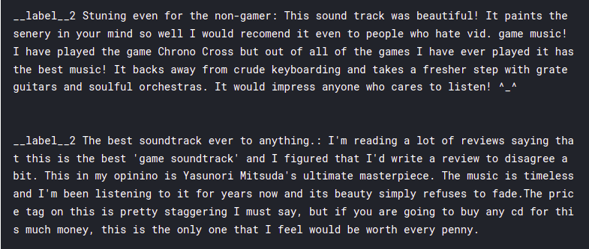
Example for unprocessed data

Slide 5
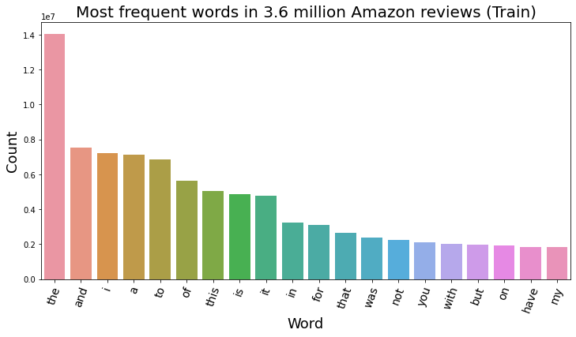
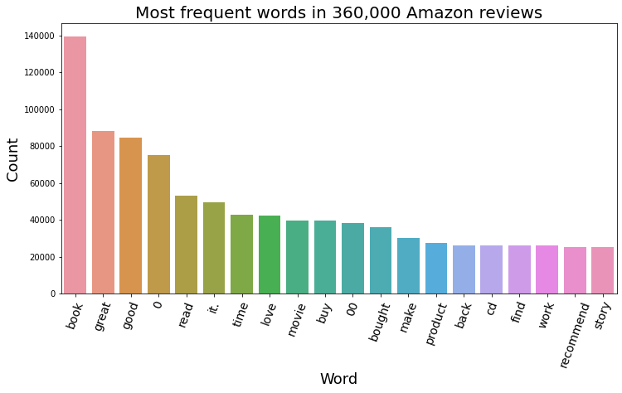
Most frequent words in reviews
Before removing stopwords: After removing stopwords:

Slide 6
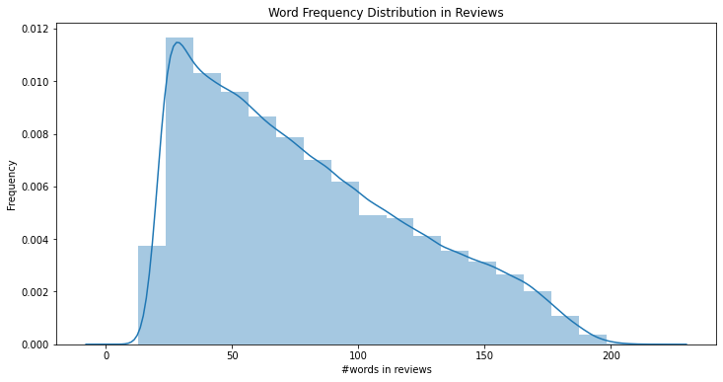
Word Count Frequency Distribution

Slide 7
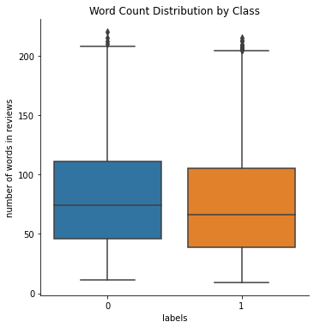
Word Count Distribution by Class

Slide 8

Data Preparation and Cleaning
Removing Punctuations
['Gfg, is best : for ! Geeks ;’]
['Gfg is best for Geeks']
Removing Digits
['He is walking to school for 30 minutes']
['He is walking to school for minutes']
Lowercasing
['He is WALKING to SCHOOL]
['He is walking to school']

Slide 9

Data Preparation and Cleaning
Removing Stopwords
['lots of tasty goodness on burdens of being upright, there was more pop flavor and more tasty hooks than on down here but down here still manages to be a better album.]
['lot','tasty','goodness','burden','upright','pop','flavor','tasty','hook','manage','good','album']
Tokenization
['He is walking to school']
['He', ‘is’, ‘walking’, 'to', 'school']
Lemmatization
['He is walking to school']
['he', 'be', 'walk', 'to', 'school']

Slide 10
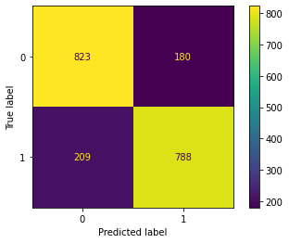
Naive Bayes Classifier
Amazon Sentiment Analysis Accuracy = 80.55
Training size: 20,000
Test size: 2,000
Vocabulary size: 54,250
Each review is encoded as a 54,250 vector (count vectorizer) with the number of appearances of each word.
Mean accuracy on 10 batches of test data:
80.925 +- 0.738

Slide 11
Naive Bayes Classifier - miss classification examples
True label: Positive( 1)
Predicted label: Negative (0)
(False Negative)
best bond movie ever! "you\'re joke-shop spies.": "the one & only, original, james bond." i\'ve been waiting since i first seen this on cable for the dvd and it didn\'t disappoint. i was already a 0-star fan before, but what makes this dvd great are the special features. for one i learned that peter sellers got fired for not showing up for one take that included scores of extras. i think he said he was ill. also, orson welles didn\'t like him & was loathed to work with him. despite this, it\'s interesting that sellers is credited as the star of the show. [...]
Amazon Sentiment Analysis Accuracy = 80.55
True label: Negative (0)
Predicted label: Positive (1)
(False Positive)
background music: frankly, i found this cd to play like a collection of b-side tunes: enjoyable background music consisting of mildly interesting pop-rock sound. however, nothing stands out to define this as an album, and there was a total absence of the melodic singles (including the overrated "vertigo") for which u0 is so well known.thankfully, edge does shine through with some very skilled guitar, saving the cd from outright disaster.highly anticipated, but disappointing effort from my favorite band.'

Slide 12
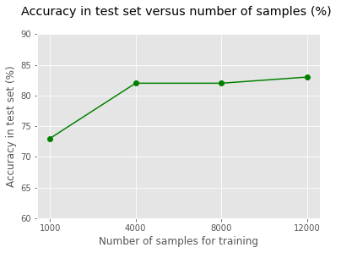
Accuracy in test set versus number of samples

Slide 13


Conclusion
It is possible to do sentiment analysis of amazon reviews to classify between positive and negative ones
Stopwords removal is essential because they are really frequent words that don’t give any information for classification
Naive Bayes achieved around 81% accuracy, probably other models would have higher accuracy because NB assumes independence among features and words in a sentence are not independent
Accuracy improved while adding more examples to training set but because of the encoding a lot of memory is required
Probably using an n-gram before encoding would give more information to the model, but it would also require more memory

